Slide 1
Is Test-Driven Development Useful to Game Developers?
A Case Study Exploring Applications to a Data-Heavy Turn-Based Strategy Game

Slide 2
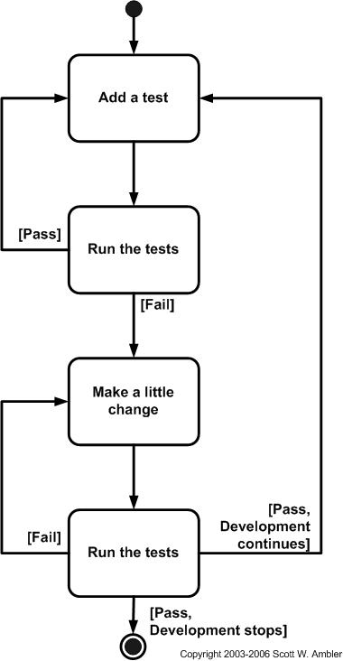
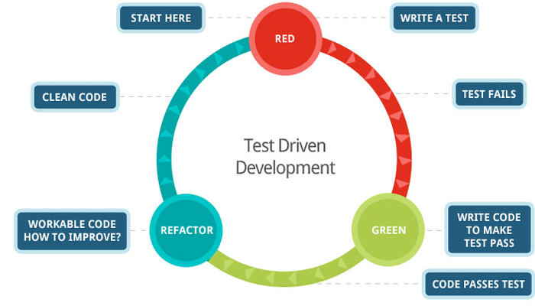
What is TDD?
Relies on the repetition of a very short development cycle.
Add a test
Run all tests and see if the new one fails
Write some code
Run tests
Refactor code
Repeat

Slide 3
General Benefits of TDD

Slide 4
Forces usage-first coding. What it does rather than how it works. Thus preventing the writing of superfluous code.
Minimises code size and complexity. Use tests to define code.
Automated unit tests show that each piece of the software does what the programmer thinks it does.
Can run these tests to validate that any changes they have made did not break already implemented features.
Allows you to rapidly and safely make changes to the project.

Slide 5
Combatting Regression
As a project grows, more features are added.
Adding new features can cause other features to break.
Hard to keep track of bugs.
Automated tests give a framework that scales with how many features are added.
New features can be added without worrying about regression.

Slide 6
Morale
Usually teams can work a long time on several features before receiving feedback.
TDD provides much more frequent feedback.
Rewards you with lots of little successes, through passing tests.
Keeps the team energized and boosts confidence.

Slide 7
Conclusion
More widely used in other Software Engineering Projects.
“we cannot TDD fun”
QA can test more for gameplay issues and ‘fun factor’.
The usefulness of TDGD is highly dependent on the type of game.
More useful in larger more complex games.
May be more useful in games with Continuous Development paths.
Longer set up time.

Slide 8
References
Grey Literature
https://www.gamasutra.com/view/feature/130120/embracing_fun_why_extreme_.php
https://www.gamasutra.com/view/news/128359/Opinion_Test_Driven_Game_Development_Experiences.php
http://chrismdp.com/2015/03/why-games-coders-dont-use-tdd-and-why-it-matters/
http://gamesfromwithin.com/backwards-is-forward-making-better-games-with-test-driven-development
https://www.gamedev.net/forums/topic/632298-tdd-in-game-development/
https://www.gamasutra.com/blogs/AlistairDoulin/20111124/90671/Test_Driven_Game_Development_Experiences.php

Slide 9
References
Academic Papers and Books
Does test-driven development really improve software design quality?
by David Janzen, Hossein Saiedian
Why do software developers practice test-driven development?
by Patrick Kayongo, Wallace Chigona, Zwelithini Mabhena
Effectiveness of Test Driven Development and Continuous Integration--A Case Study
by Chintan Amrit, Yoni Meijberg
A Dissection of the Test-Driven Development Process: Does It Really Matter to Test-First or to Test-Last?
by Davide Fucci, Hakan Erdogmus, Burak Turhan, Markku Oivo, Natalia Juristo
Test-Driven Development – By Example
By Kent Beck

Slide 10
Thank you for listening!

